Slide 1
CUSTOMER CHURN BUSINESS ANALYSIS End-to-End Data Analysis Capstone Project
Presented By: SHAIKH Aliya Alim
Tools Used: Python | Pandas | Seaborn | Matplotlib

Slide 2
Project Overview
This project performs an end-to-end analysis of customer churn data.
The analysis includes:
1.Data validation and cleaning
2.Exploratory Data Analysis
3.Data visualization
4.Statistical analysis
5.Hypothesis testing
6.Business recommendations
Goal: Identify important factors associated with customer churn and provide actionable recommendations.

Slide 3
Business Problem
Customer churn occurs when customers stop using a company's services.
High churn can result in:
- Revenue loss
- Reduced customer base
- Higher customer acquisition costs
Key Question
What factors are associated with customer churn, and how can the business improve customer retention?

Slide 4
Project Objectives
1. Analyze customer churn patterns
2. Identify important customer characteristics
3. Compare churn across different customer groups
4. Perform statistical hypothesis testing
5. Develop actionable business recommendations
6. Create a practical retention implementation plan

Slide 5
Dataset Overview
Dataset
Important Variables
Total Records: 500
Total Features: 9
Monthly Charges
Total Charges
Contract Type
Payment Method
Paperless Billing
Senior Citizen
Customer Tenure
Customer Churn
Data Quality
✅ No Missing Values ✅ No Duplicate Rows ✅ Dataset Successfully Validated

Slide 6
Data Analysis Workflow
Raw Dataset
↓
Data Cleaning & Validation
↓
Exploratory Data Analysis
↓
Statistical Analysis
↓
Hypothesis Testing
↓
Business Insights
↓
Recommendations
Tools Used: Python, Pandas, Seaborn, Matplotlib, SciPy

Slide 7
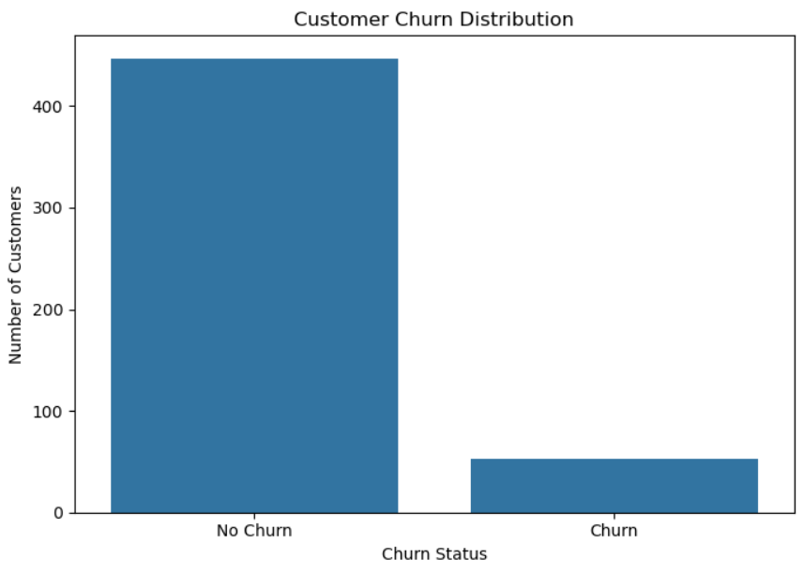
Overall Customer Churn
Customer Churn Distribution
Key Insight
Although most customers remained with the company, 10.6% of customers churned, making customer retention an important business concern.
Key Result:
Total Customers: 500
Customers Retained: 447
Customers Churned: 53
Overall Churn Rate: 10.6%

Slide 8
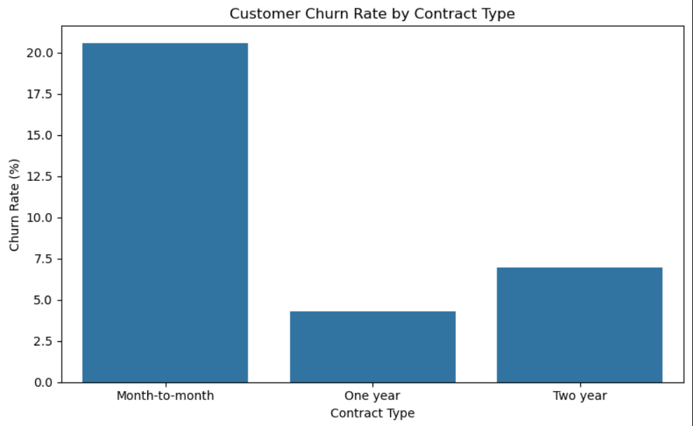
Contract Type Analysis
Churn Rate by Contract Type
Key Insight
Contract Type | Churn Rate
Month-to-month | 20.59%
One year | 4.30%
Two year | 6.94%
Month-to-month customers showed the highest churn rate.
This suggests that encouraging customers to move toward longer-term contracts may improve customer retention.

Slide 9
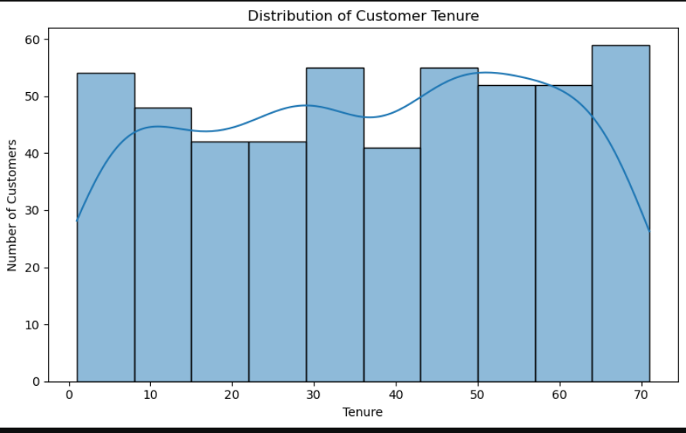
Customer Tenure Analysis
Customer Tenure and Churn
Statistical Result
P-value: Sta8.98 × 10⁻¹³⁰
Result: Statistically Significant
Customer Group | Average Tenure
Non-Churned | 40.15
Churned | 6.00
Key Insight
Customers who churned had substantially lower tenure.
🎯 Early-stage customers appear to be an important high-risk group.

Slide 10
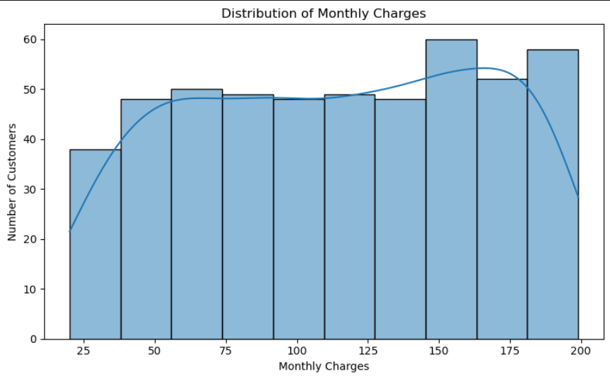
Monthly Charges Analysis
Monthly Charges and Customer Churn
Statistical Result
Customer Group | Average Monthly Charges
Non-Churned | 111.72
Churned | 129.77
P-value: 0.0101
Result: Statistically Significant
Key Insight
Churned customers had higher average Monthly Charges.
This indicates that Monthly Charges are associated with customer churn in this dataset.

Slide 11
Statistical Analysis Summary
95% Confidence Interval
Average Monthly Charges:
109.08 – 118.19
Key Insight
Customer tenure and Monthly Charges showed statistically significant differences between churned and non-churned customers.
Statistical Analysis Results
Analysis | Result
Tenure vs Churn | ✅ Significant
Monthly Charges vs Churn | ✅ Significant
Total Charges vs Churn | ❌ Not Significant

Slide 12
Key Findings
🎯 Early-stage customers have higher churn risk
📄 Month-to-month contracts had the highest churn rate (20.59%)
💰 Churned customers had higher Monthly Charges
📊 Overall churn rate was 10.6%
🔍 Customer tenure showed the strongest association with churn

Slide 13
Business Recommendations
Focus on Early Customer Retention
Improve onboarding and early engagement.
2. Encourage Longer-Term Contracts
Provide incentives and loyalty benefits.
3. Review Pricing Strategies
Improve value for higher-paying customers.
4. Improve Payment Experience
Investigate differences across payment methods.
5. Monitor High-Risk Customers
Create a proactive churn monitoring system.

Slide 14
Implementation Plan
Customer Retention Implementation Plan
Phase 1: Identify Risk
Identify customers with:
Low tenure
Month-to-month contracts
Higher Monthly Charges
⬇️
Phase 2: Retention Campaigns
Welcome programs
Personalized offers
Loyalty rewards
Contract upgrade incentives
Phase 3: Monitor Performance
Track:
Churn Rate
Retention Rate
Contract Conversion
Campaign Performance
⬇️
Phase 4: Continuous Improvement
Use new customer data to improve retention strategies.

Slide 15
Conclusion
This project performed an end-to-end customer churn analysis using 500 customer records.
The analysis identified important factors associated with customer churn, particularly:
Customer Tenure
Contract Type
Monthly Charges
Final Business Message
Data-driven customer retention strategies can help businesses identify high-risk customers and reduce churn proactively.

Slide 16
THANK YOU

